Slide 1
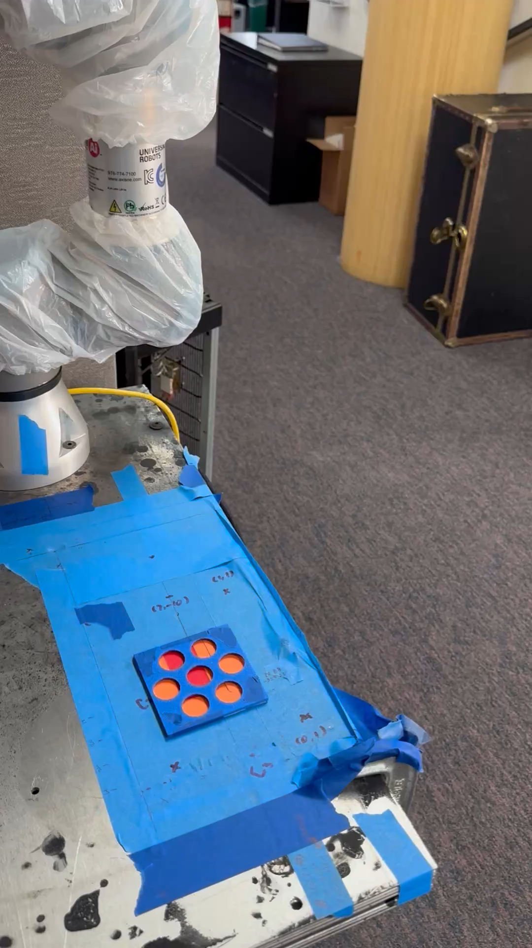
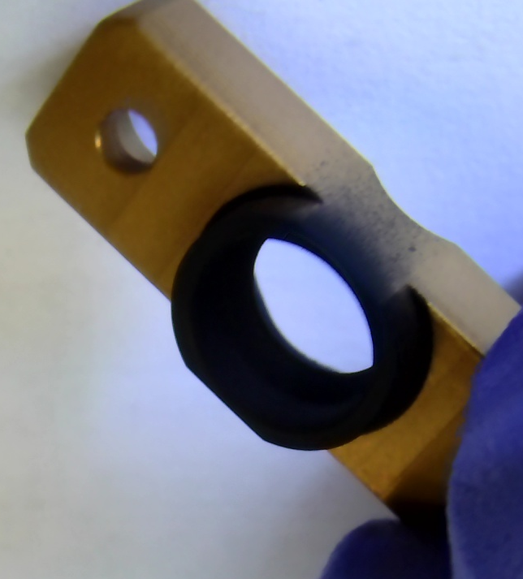
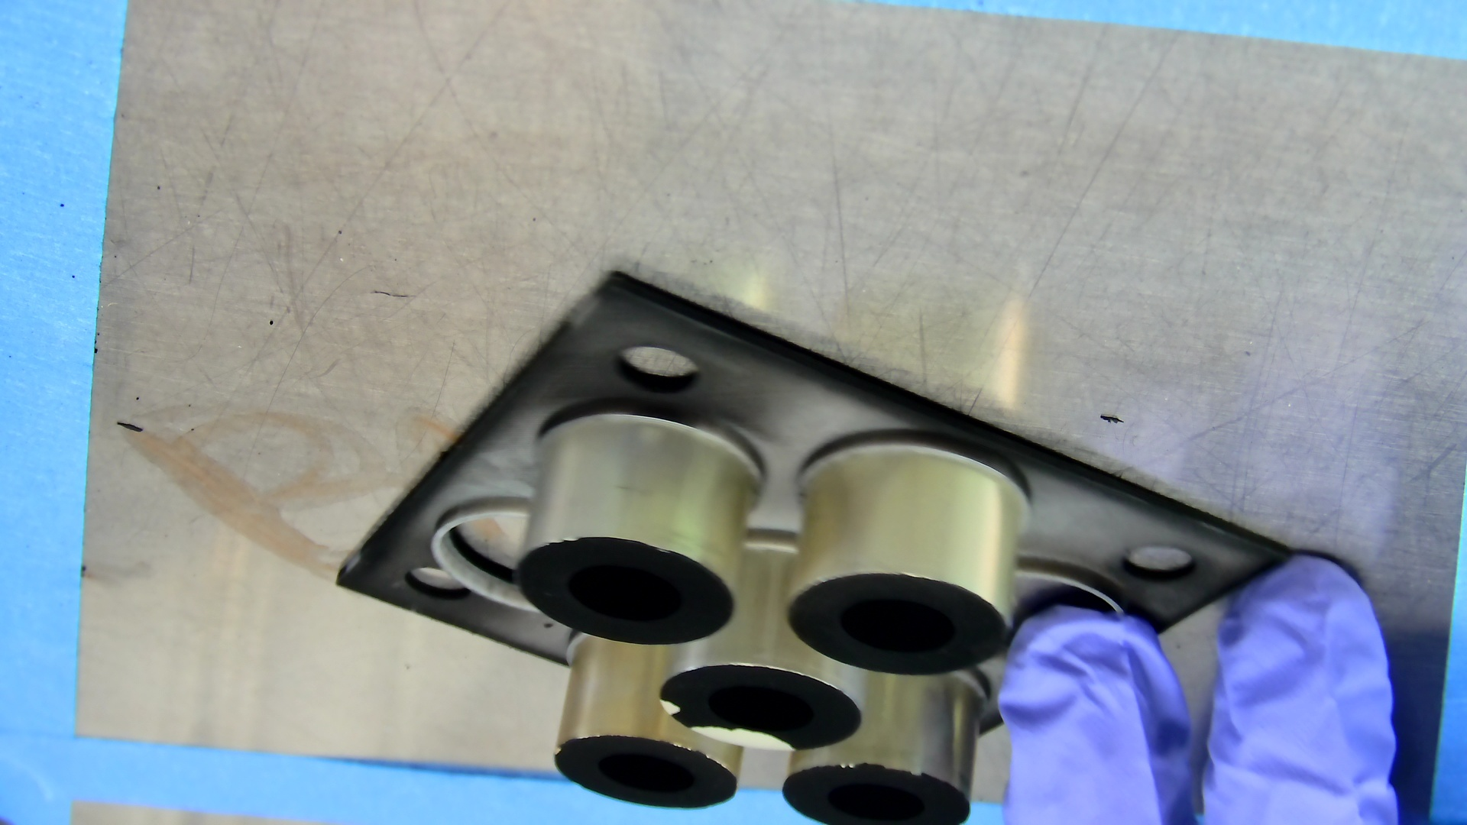
Project Background:
The previous goal is to use a robotic system to spray paint and coat parts automatically.
Previously, I implemented a binary blob search algorithm to locate part positions accurately. This allowed the robot to apply paint precisely by using a camera positioned above the parts, eliminating the need for manually locating part centers.
After the spray process, technicians inspect the parts for issues such as overspray (Figure b) or missing paint chips (Figure c). They clean or rework the parts as necessary to ensure quality standards are met.
(b) Overspray (c) Missing Chips
(a) Video of Previous Project

Slide 2
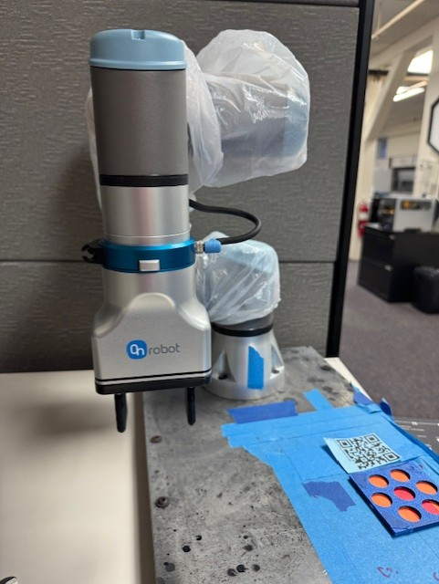
With the availability of a robot gripper, we can now pick up and place objects during the process. Our objective is to develop an object detection system to determine whether the parts are well-cleaned. The robot will pick up each part and present it to the camera for inspection.
Given the limited number of images available for each part, we have chosen to use YOLO (You Only Look Once) as our object detection model due to its efficiency with smaller datasets.
Finally, based on the inspection results, the parts will be categorized and placed in two different areas: Pass or Failed.

Slide 3
Project Outline:
Ze’s part
Lucas’s part
Part Pickup and Presentation
Use the robot gripper to pick up the part from the designated input area.
Present the part to the camera at multiple angles, ensuring all surfaces are visible for inspection.
Rotate or reposition the part as needed to capture a comprehensive view.
Image Capture and Analysis
Capture high-quality images or video frames of the part using a camera.
Save the captured images or process live images for further analysis.
Implement a YOLO-based object detection system to assess whether the part is well-cleaned.
Decision-Making
Classify the part as either Pass or Failed.
Data Logging and Reporting
Maintain a log of inspected parts, including inspection time, classification results, and image data.
Generate periodic reports to analyze the system's performance and improve efficiency.

Slide 4
Project Deliverables:
Image Processing
Prepare box coordinates for the images.
Ensure all necessary files for training are ready.
Implementation Steps
Document the entire training process clearly.
Save the model's weight files after training.
System Integration
Explain how the machine learning model will be integrated with the robot system.
Include information about the software, frameworks, or tools required for integration.
Future Improvements
Plan how to expand the dataset or improve the model with real-time feedback.
Suggest solutions if the hardware or parts design changes in the future.
Timeline and Milestones
Create a step-by-step timeline for the machine learning tasks.
Include key milestones, such as preparing the dataset, training the model, testing, and deploying it.

Slide 5
Additional Details:
Robot Details
Type: UR3e
Gripper: OnRobot 2FG7 gripper
Programming language
Python
Collaboration Workflow
GitHub: For sharing progress, code, and updates.
Google Drive: For sharing datasets and large files.

